Slide 1
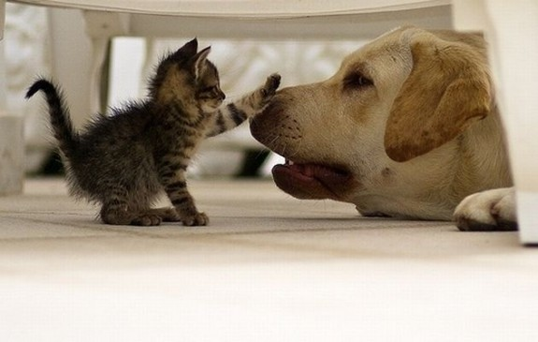
Captioning, Computerized
By Matt Edrich
“a small black and white object with a white and white label”

Slide 2
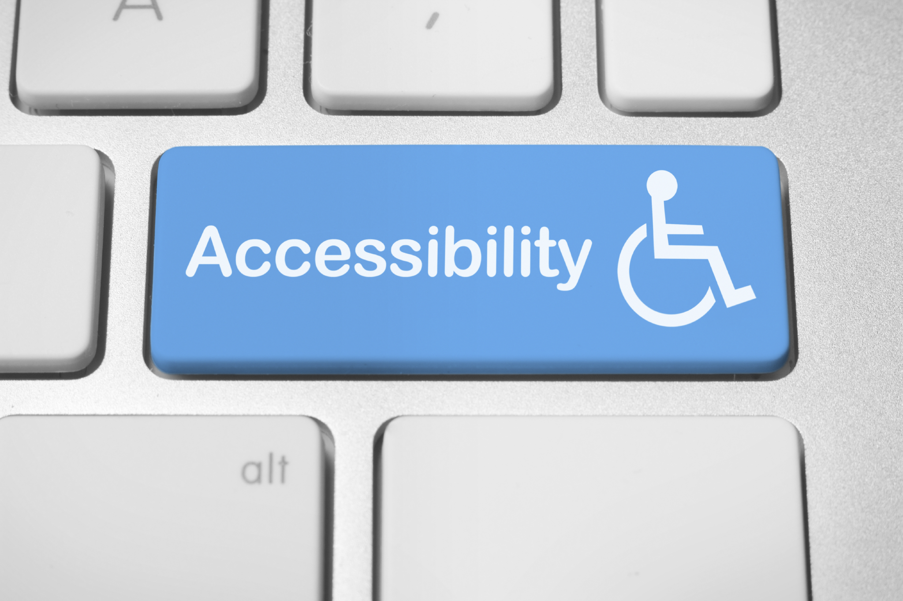
Motivation
People who are blind are (mostly) reliant on human-powered captioning services to understand images they take.
If a computer could produce an accurate caption for a given image, blind users could find themselves one step closer to an equitable digital experience.

Slide 3
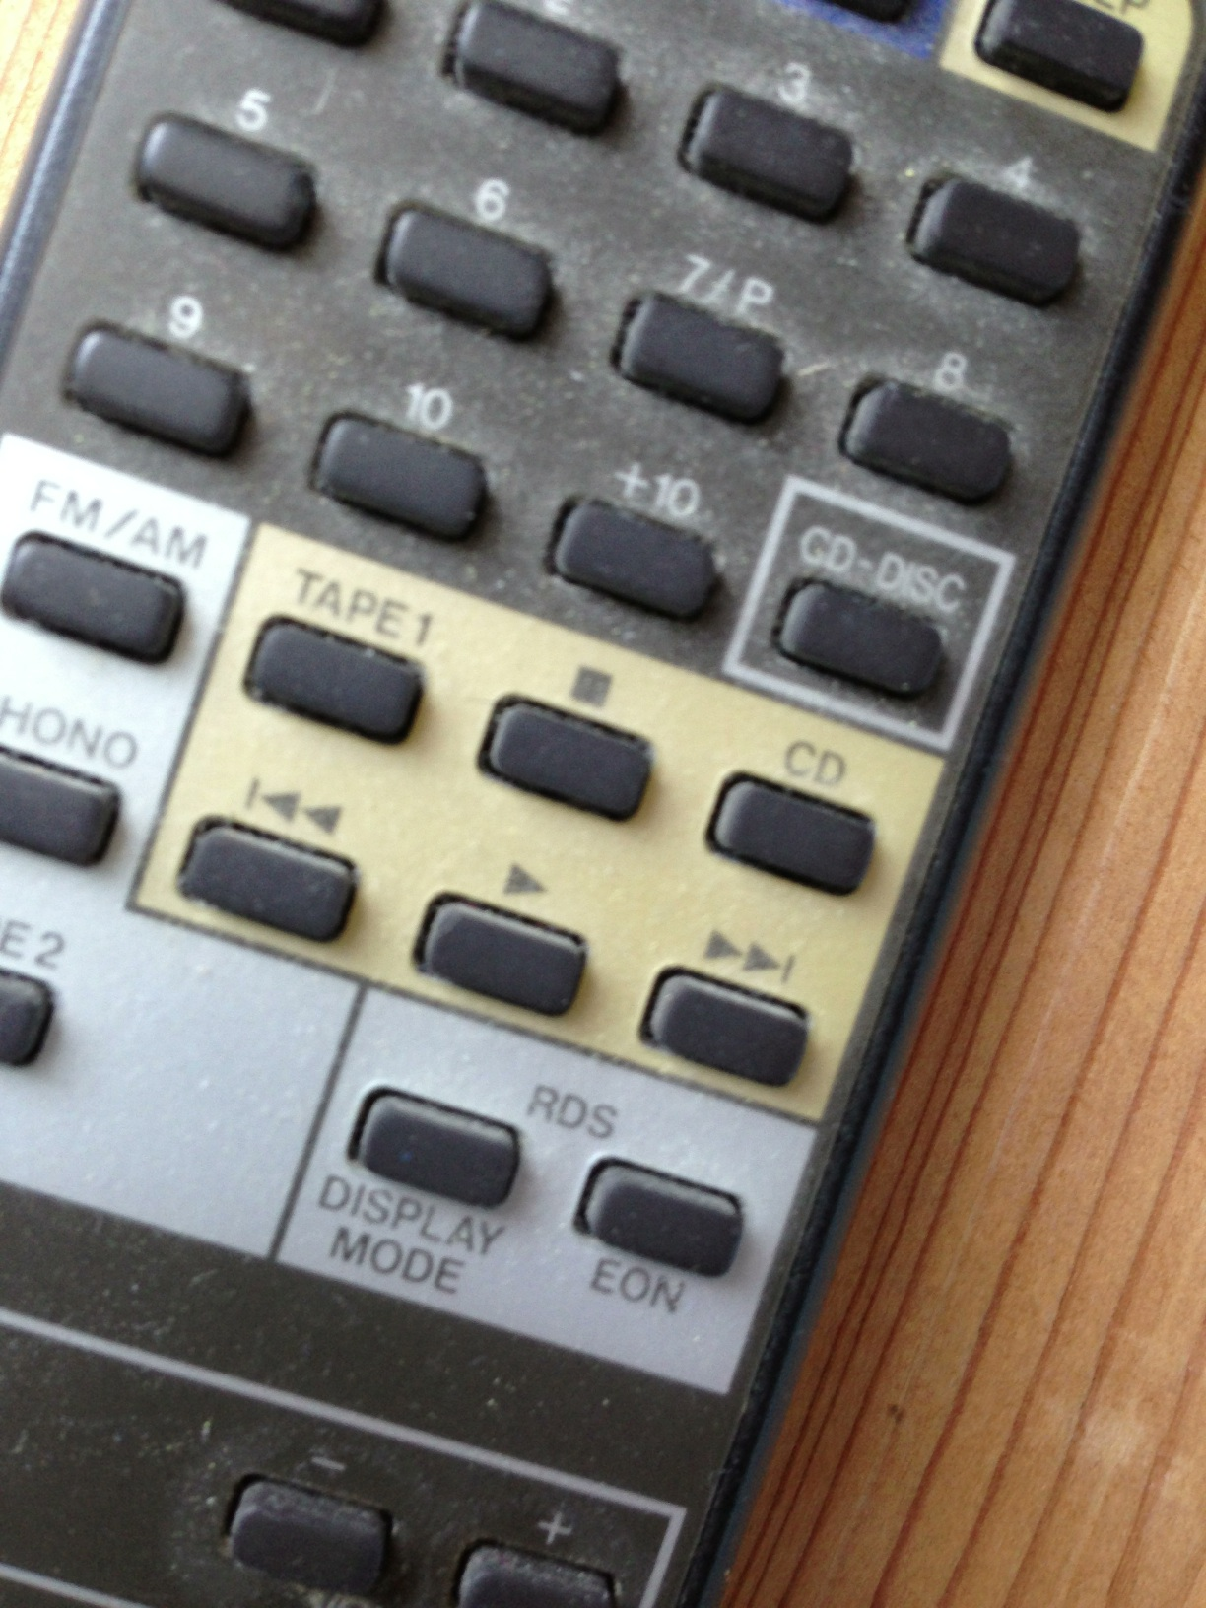
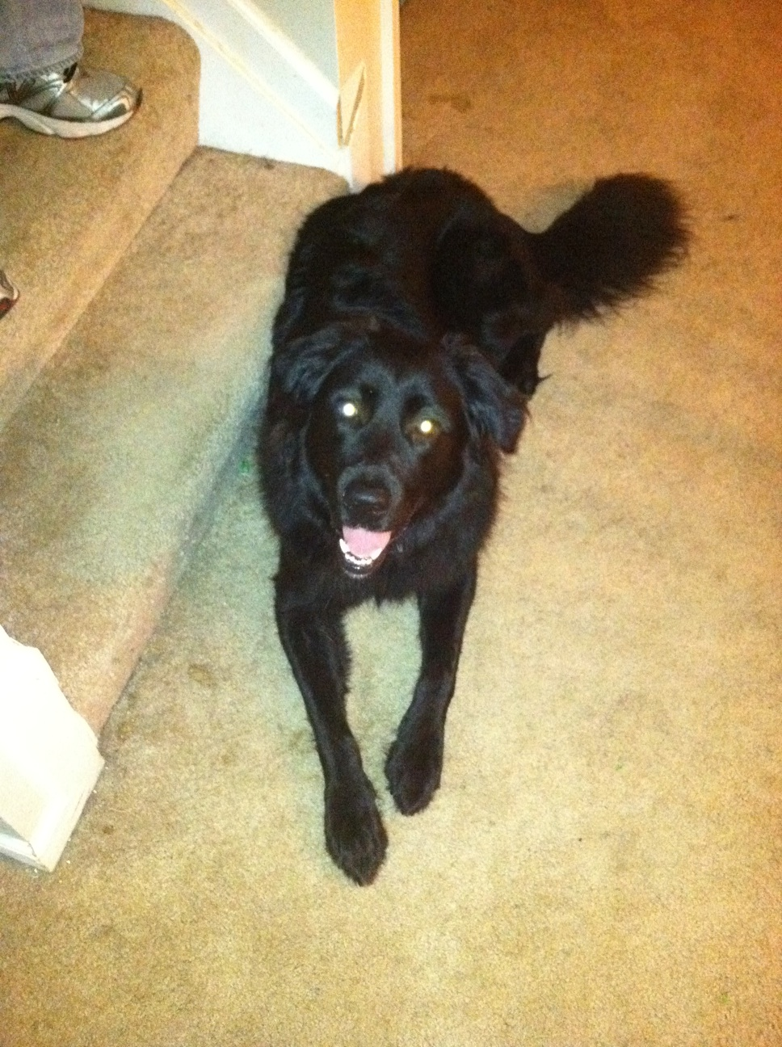

Data
The VizWiz-Captions dataset:
23,000+ training images with 5 associated captions per image
7,750 validation images with 5 associated captions each
8,000 test images with 5 hidden captions each
Machine Learning competition aimed at computer vision from 2020
All images generated by blind users

Slide 4
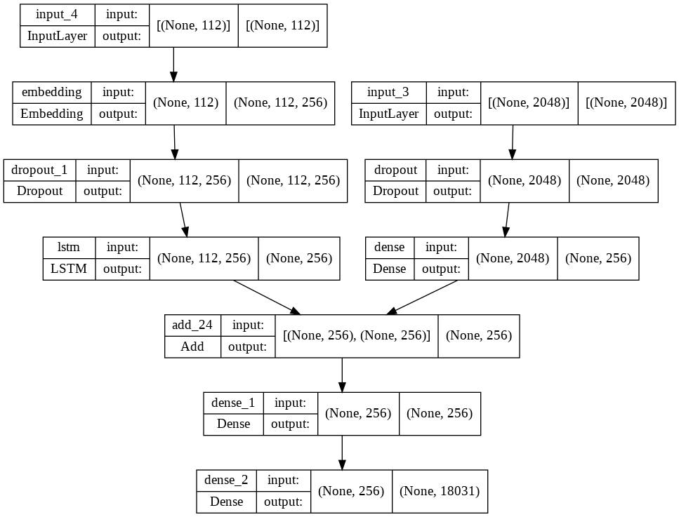
Design
Overall design has two parts: image classification + sequence prediction
Convolutional neural network (+ Xception transfer learning) for image recognition
Recurrent neural network for sequence prediction
In a nutshell, extract features from images and encode them as a decodable sequence
Finally, decode the sequence!

Slide 5
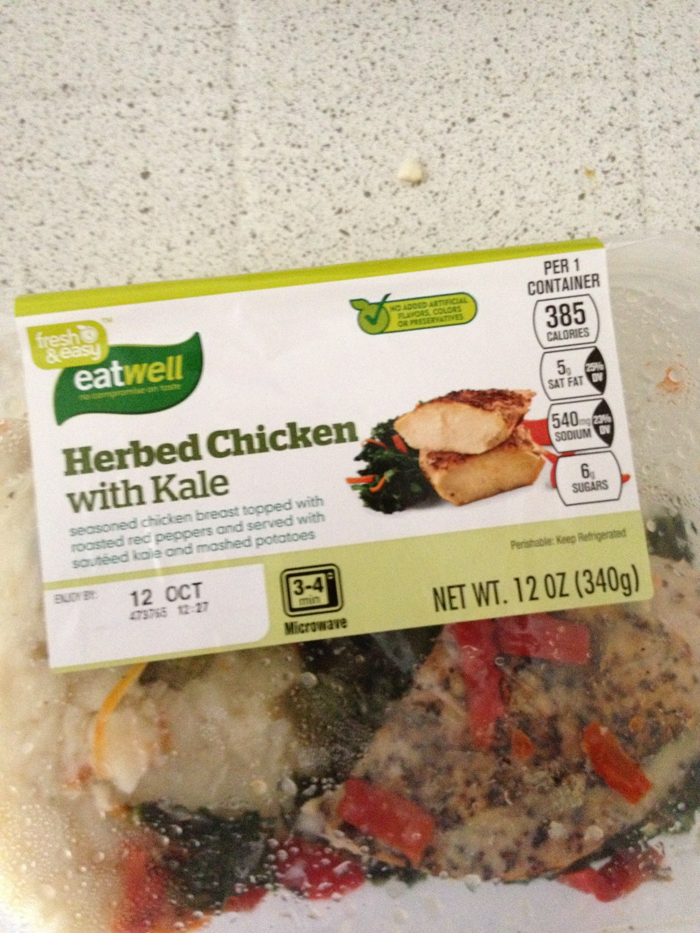
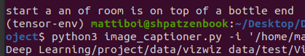
Performance
As of this presentation, the ‘best performing model’ clocked in with an accuracy of 43.4%
However, the kernel running that analysis died in the middle of the run - many times
Due to data wrangling issues, it is questionable what ‘accuracy’ means in this case
Other, earlier models (sans metrics) appear to perform better…

Slide 6
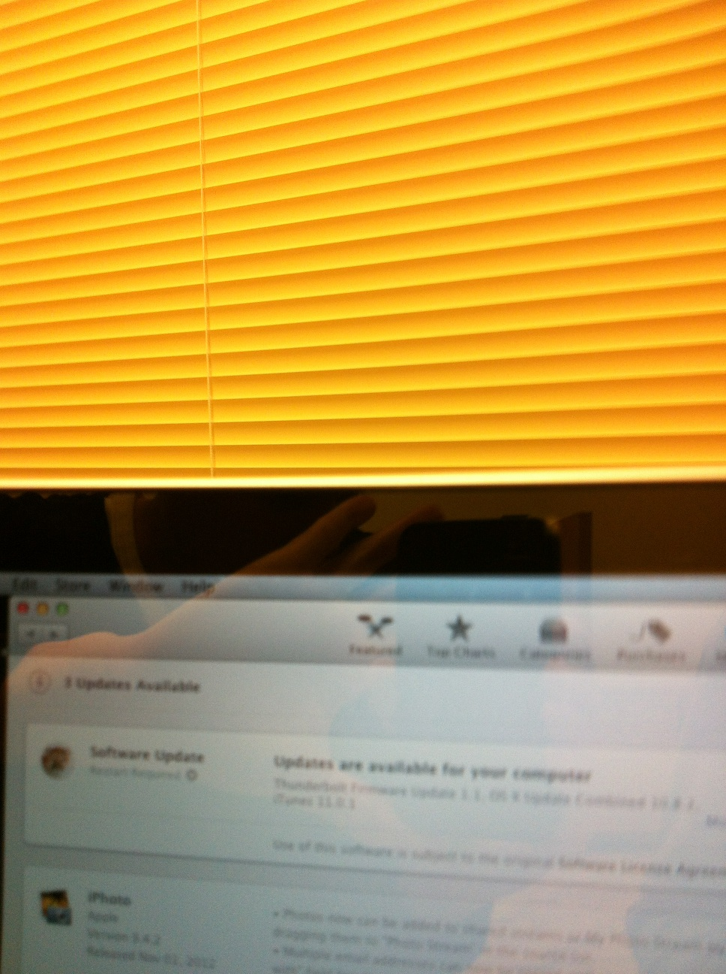
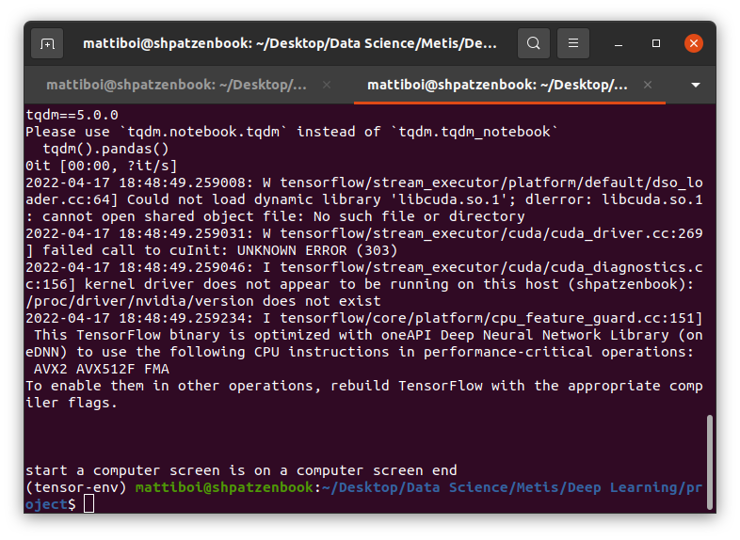
Utility

Slide 7
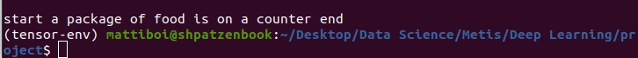
Utility

Slide 8
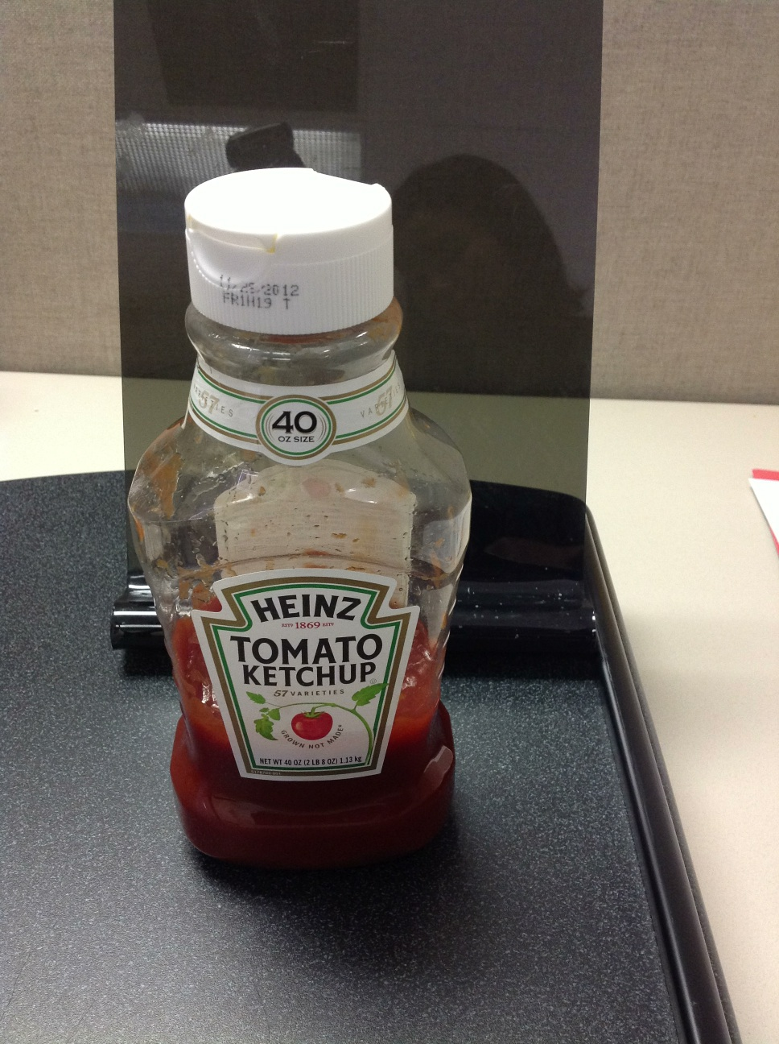
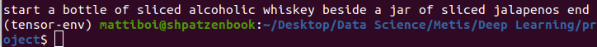
Utility

Slide 9
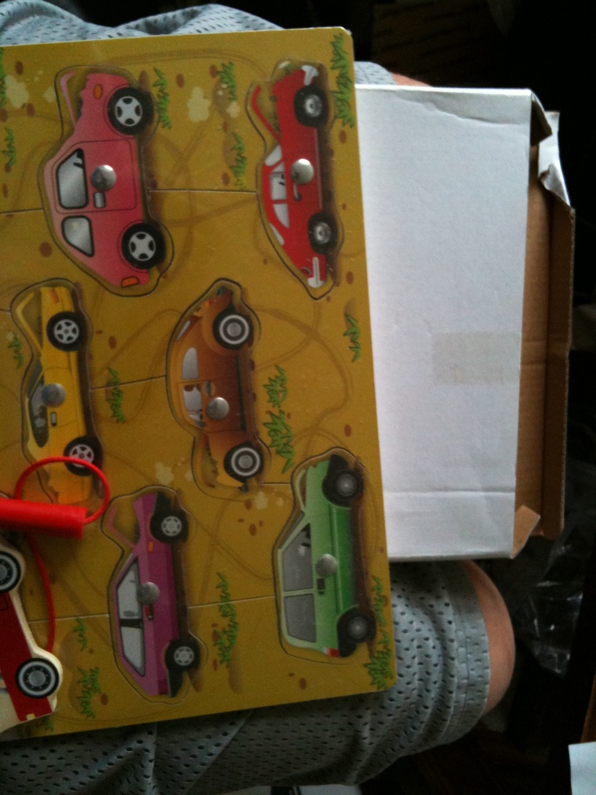
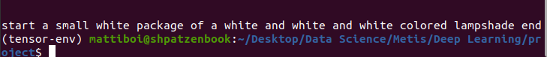
Utility

Slide 10

Conclusions & Future Work
My image captioner leaves a lot to be desired!
The best performing model really struggles to distinguish objects that have words or digits on them
Objects that look like other objects are a serious challenge
Future Work:
Wrangle the data better to be more confident in reported metrics
Transfer learning from a different model
Redesign/add to model architecture
Process with better local hardware

